Slide 1
Vertebrate Animals

Slide 2
I- Phylum: Chordata
A) 3 basic characteristics
1) presence of a notochord
a) flexible, rod-like structure
b) replaced by backbone in adults
2) presence of dorsal nerve cord
a) hollow tube
b) becomes brain and spinal cord
3) presence of gill slits (at some point)
a) passage of water/oxygen

Slide 3
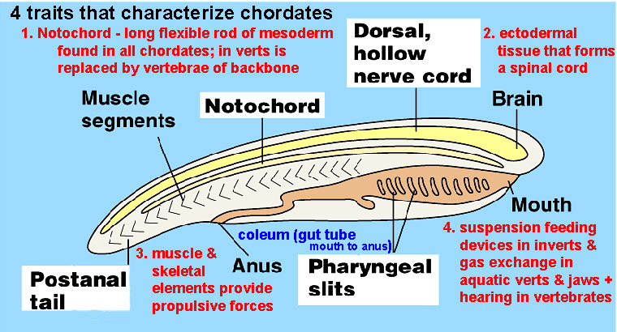

Slide 4
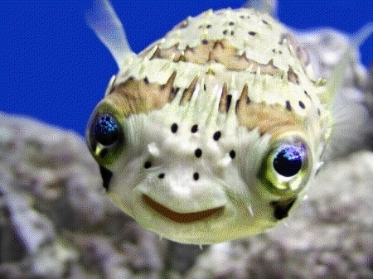
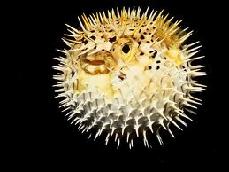
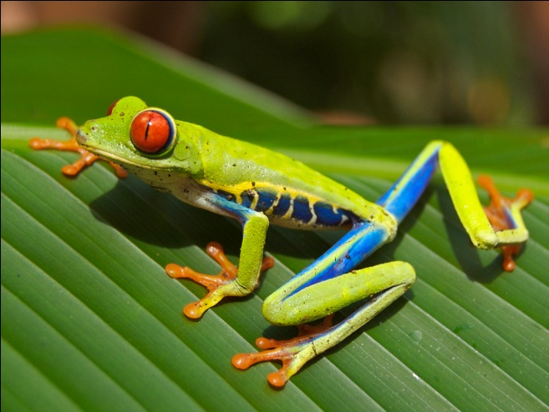
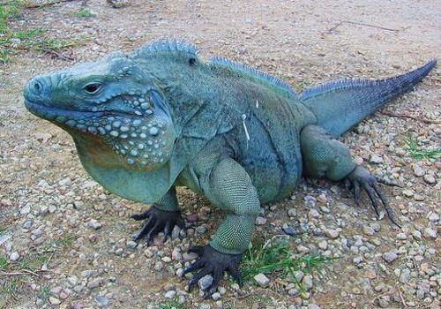
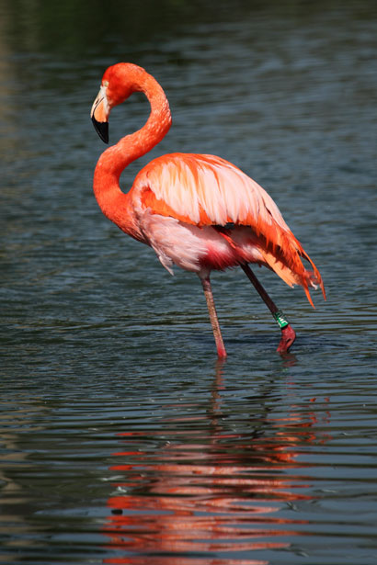
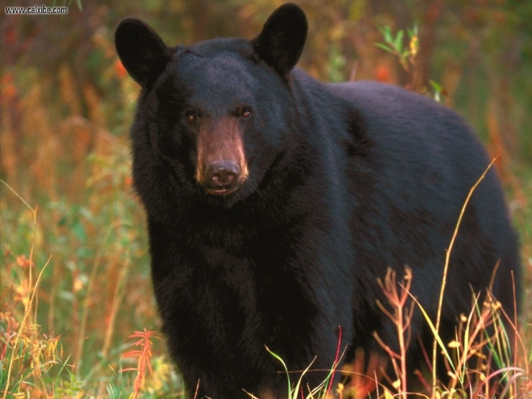
B) 5 major classes
1) fish
2) amphibians
3) reptiles
4) birds
5) mammals

Slide 5
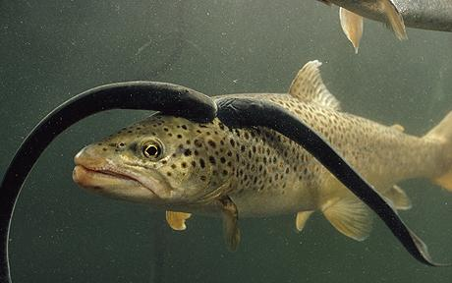
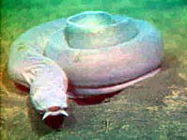
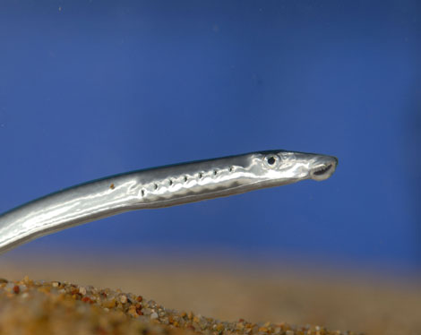
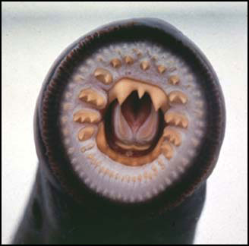
II) Fish
A) Agnatha: jawless fish
1) suction mouth
2) notochord remains
a)lack bony skeleton → cartilage
3) ex. lamprey and hagfish

Slide 6
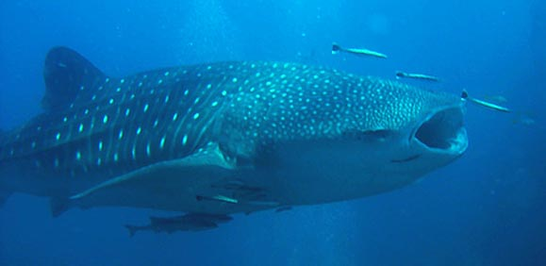
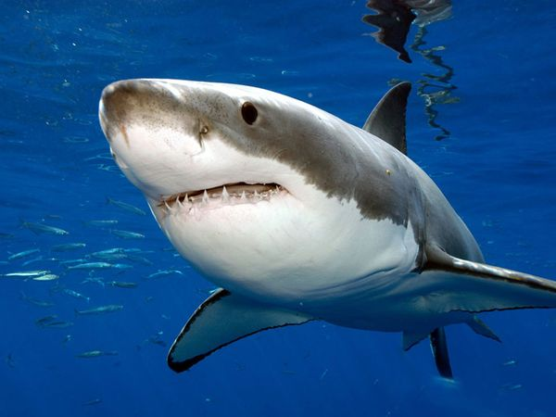
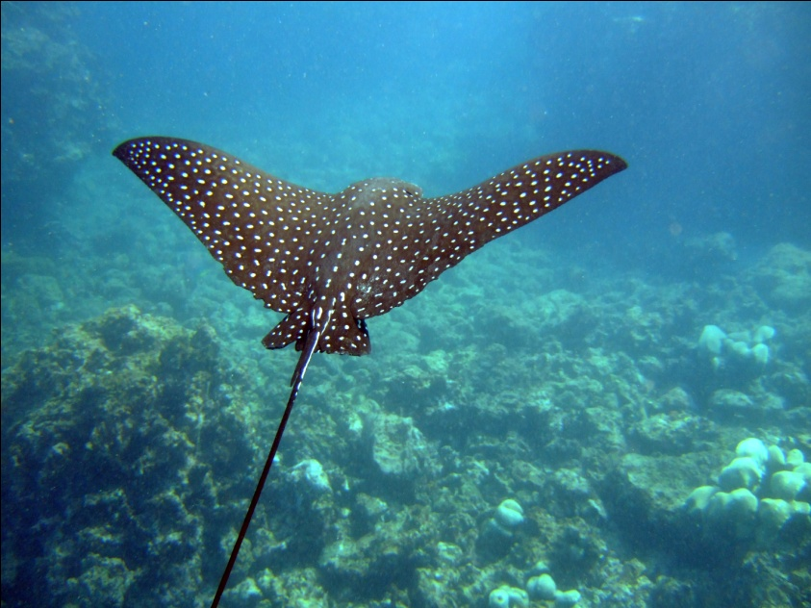
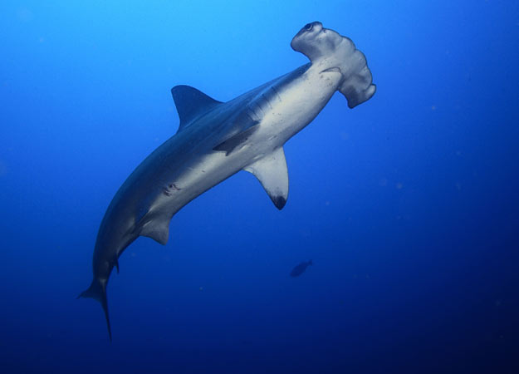
B) Chondrichthyes: cartilage fish
1) moveable jaw
2) skeleton made of cartilage
3) ex. sharks and rays

Slide 7
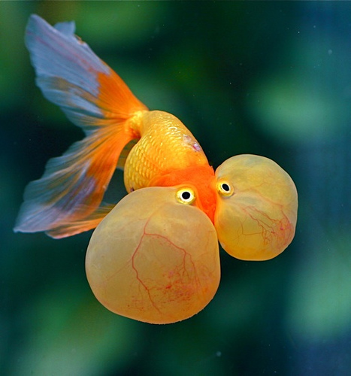
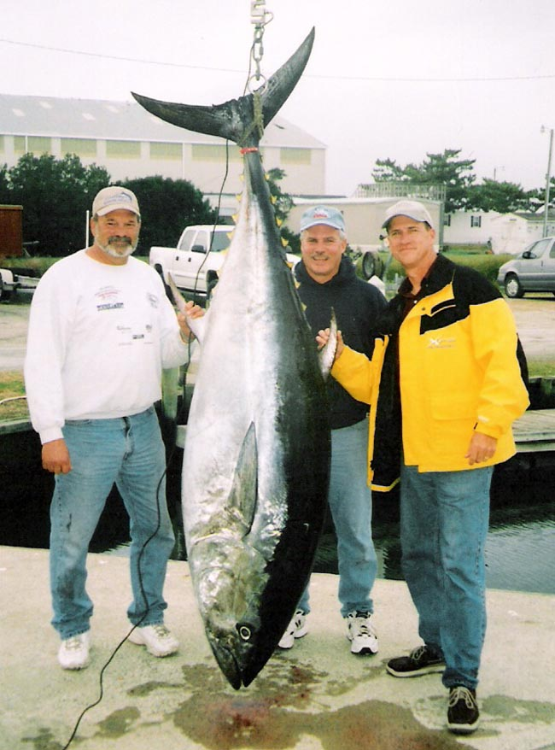
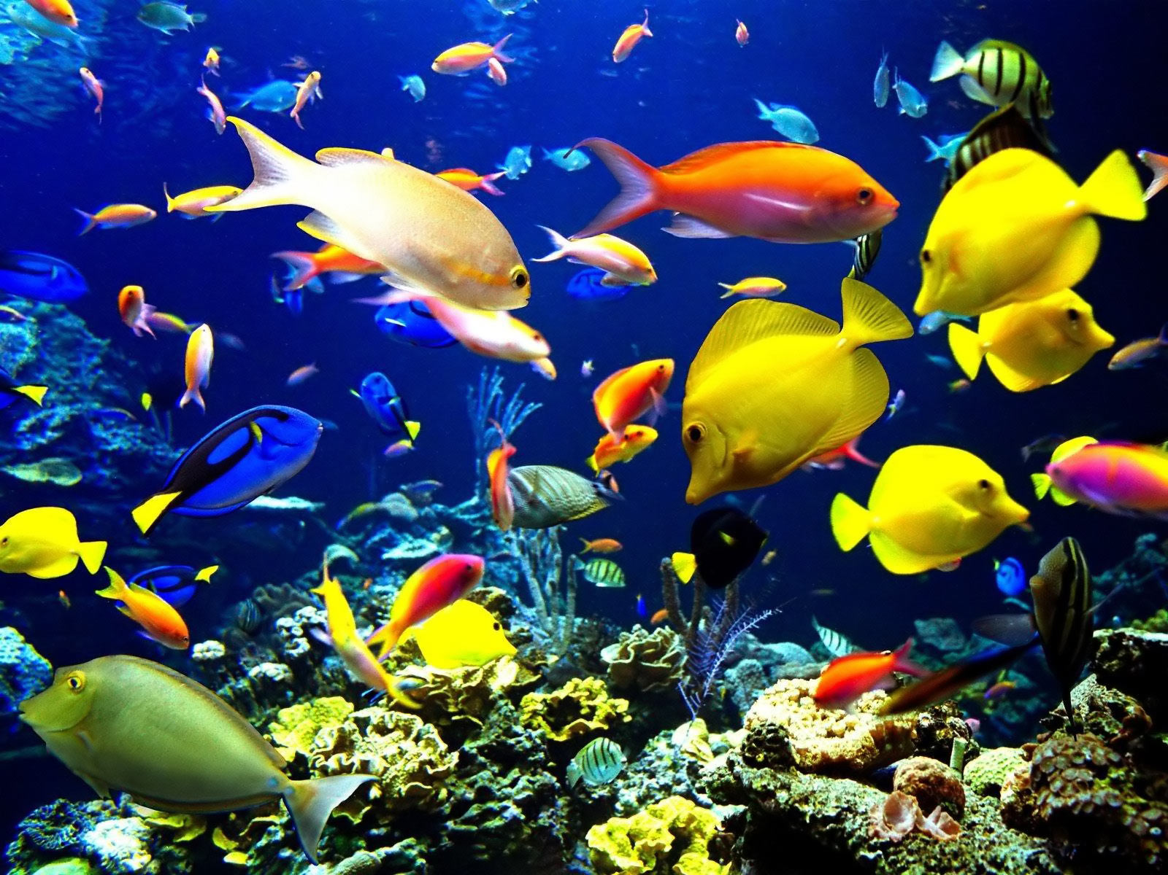
C) Osteichthyes : bony fish
1) skeleton made of bone
2) presence of a swim bladder
3) ex. tuna, trout, salmon, goldfish

Slide 8
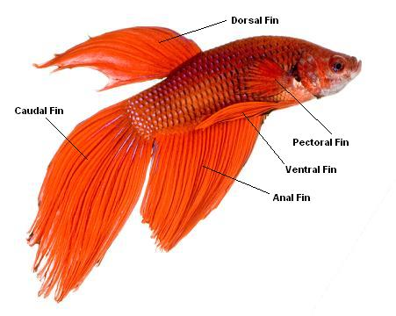
D) general charachteristics
1) ectotherms (can’t regulate body temperature)
2) gills used for respiration
3) body covered in scales
4) fins aid in movement
5) digestion, respiration, circulatory,
excretory, nervous and reproductive systems

Slide 9
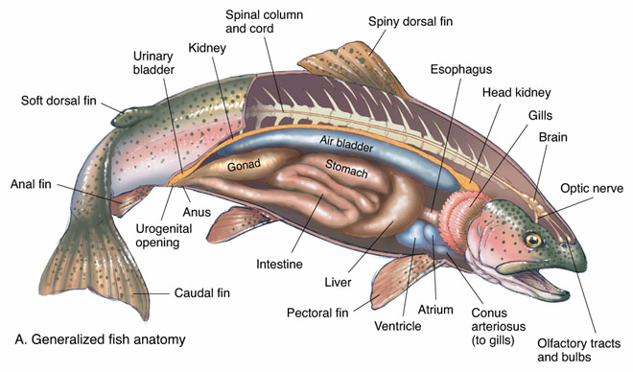

Slide 10
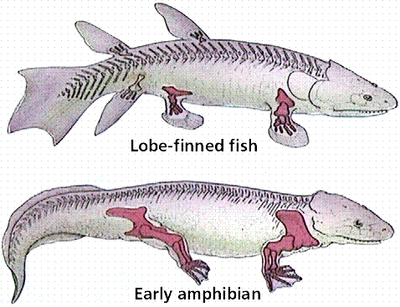
III) Amphibians
A) evolution of the tetrapod
1) fins develop into limbs

Slide 11
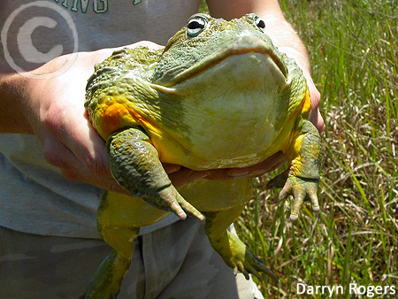
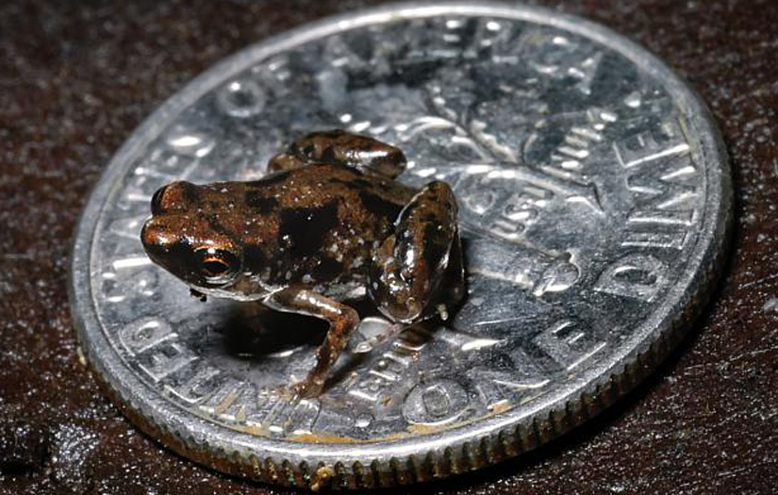
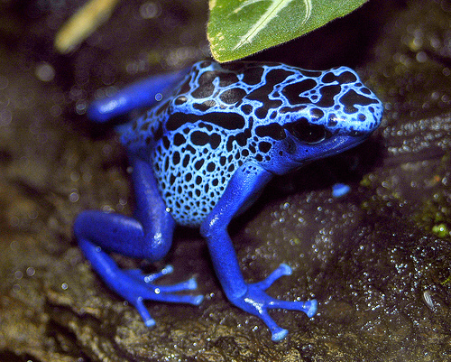
B) 3 classes
1) frogs
2) toads
3) salamanders

Slide 12
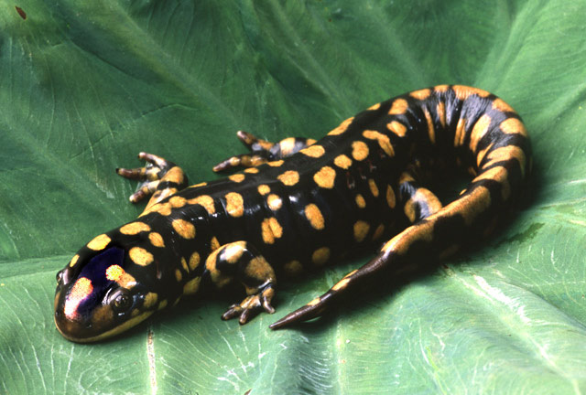
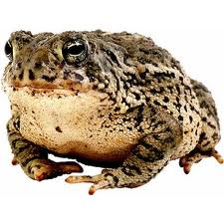
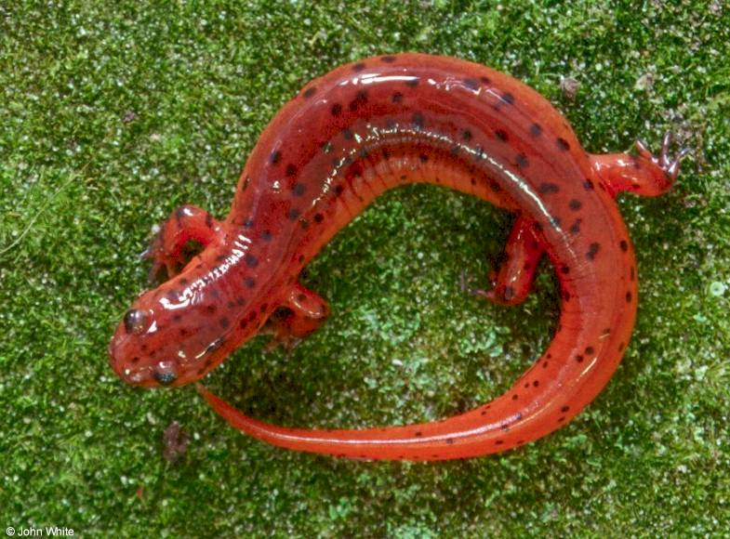

Slide 13
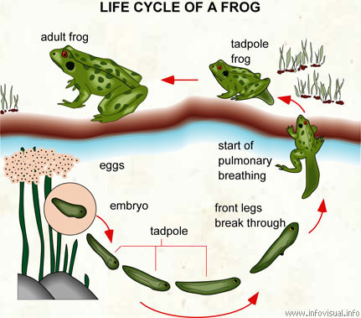
C) live a portion of life cycle in water
1) reproduction (external fertilisation)
2) metamorphosis

Slide 14
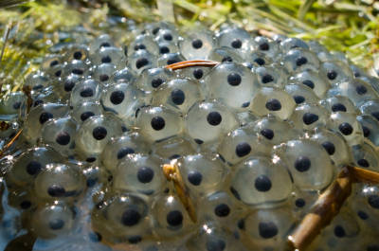
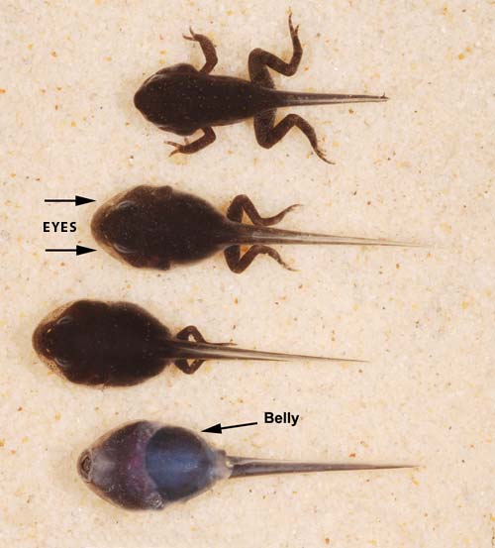

Slide 15
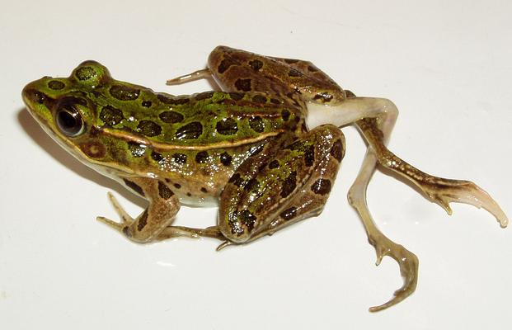
D) life on land
1) lungs
2) moist, smooth skin for gas exchange
a) risk of drying out
b) gravely affected by pollution
3) ectothermic

Slide 16
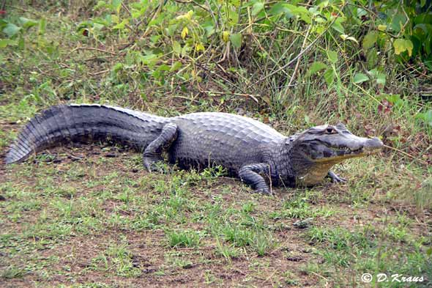
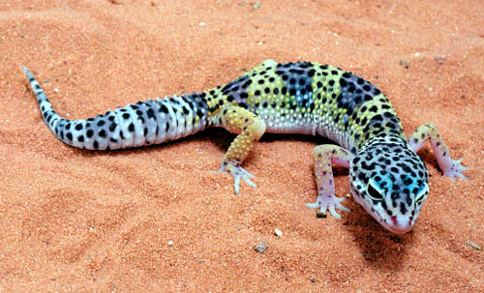
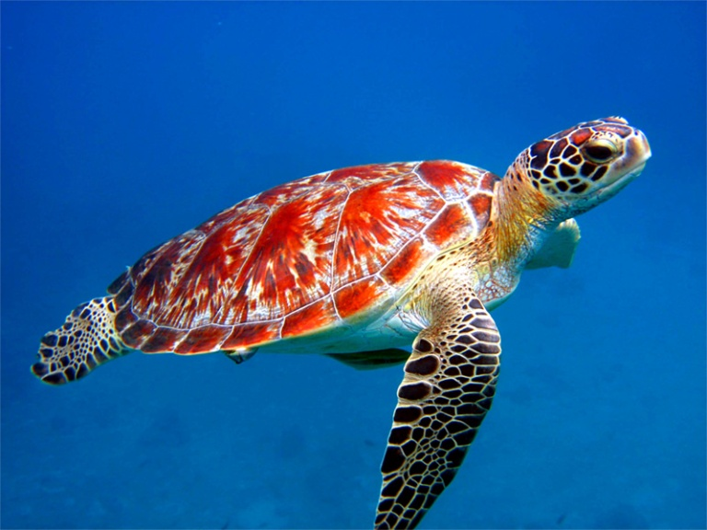
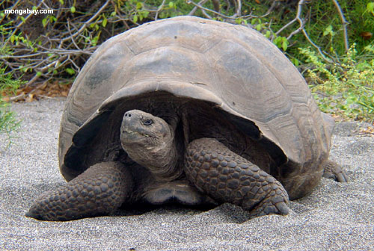
IV) Reptiles
A) 4 major groups
1) lizards
2) snakes
3) turtles
4) crocodilians

Slide 17
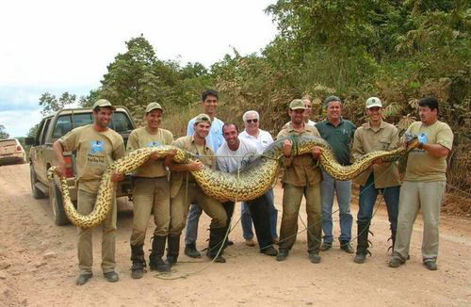

Slide 18
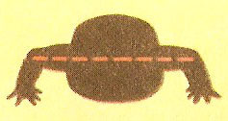
B) fully adapted to life on land
1) scales (prevent dehydration)
2) lungs for gas exchange
3) limbs point downward, with claws

Slide 19
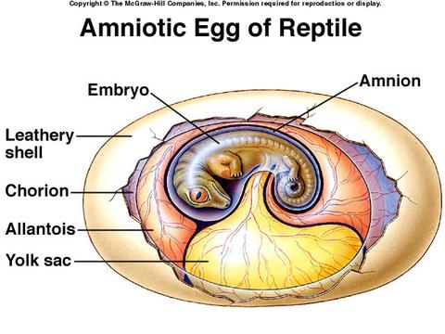
4) ectothermic (basking)
5) internal fertilisation
6) development of egg with a shell
a) amniotic egg

Slide 20
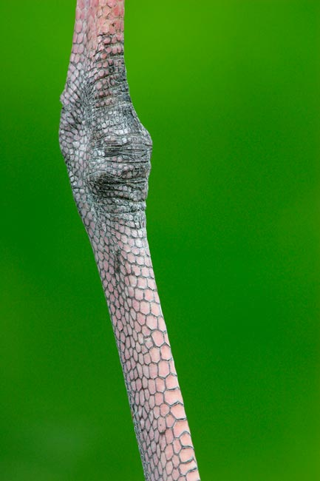
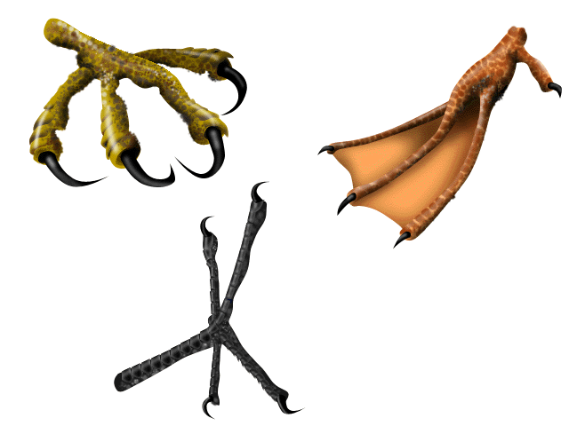
V) Birds
1) 2 legs + 2 wings
a) scales & claws on leg

Slide 21
2) body covered in feathers
a) made of keratin (like scales of reptiles)
b) hollow tube = light weight
c) several functions
i) warmth (down feathers)
ii) coloration
iii) flight*** (several adaptations)
d) molting

Slide 22
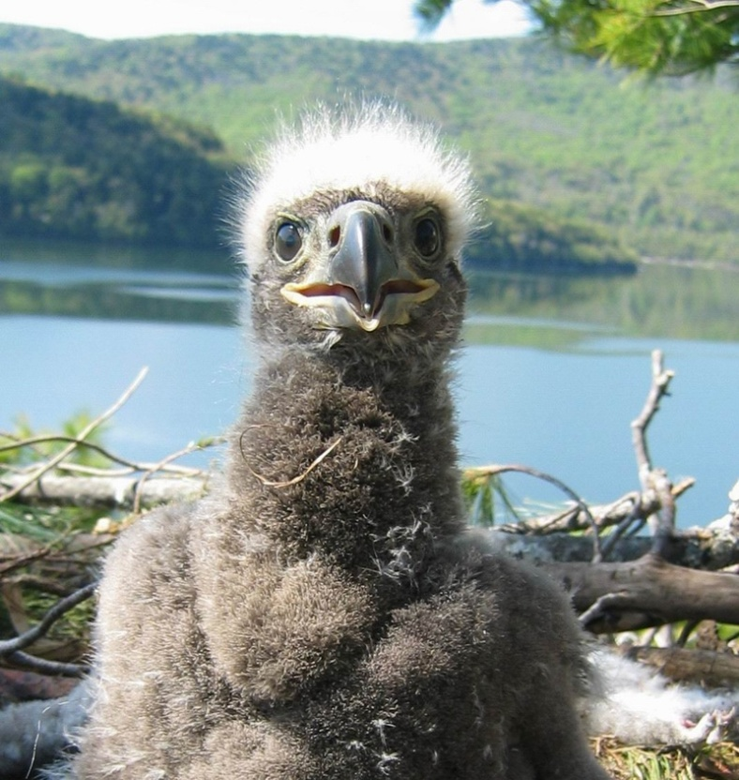
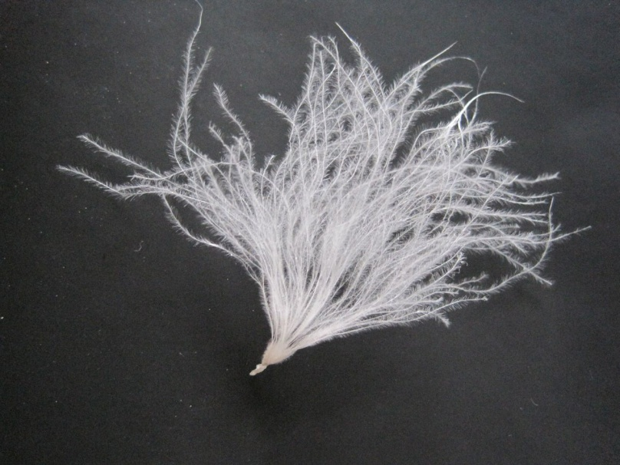
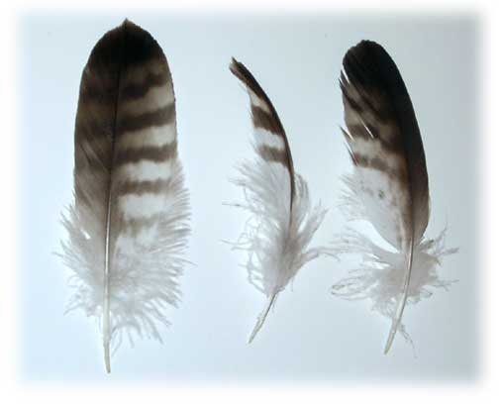
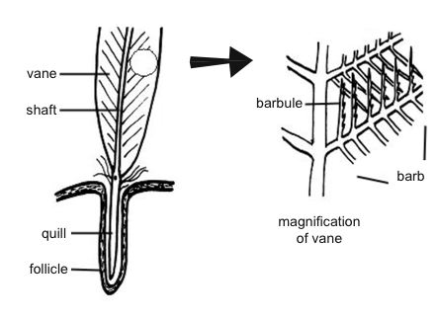

Slide 23
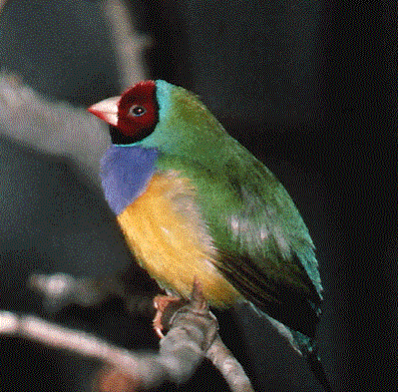
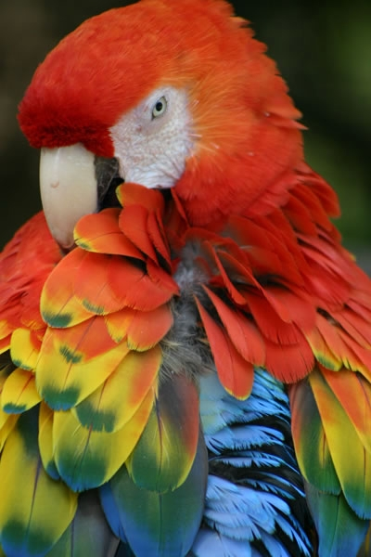

Slide 24
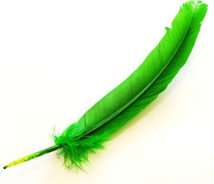
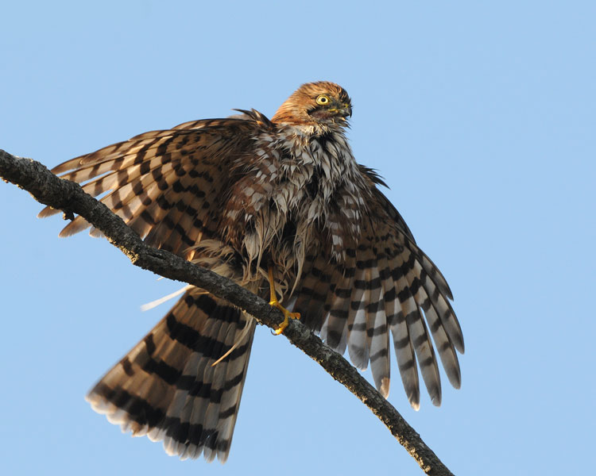

Slide 25
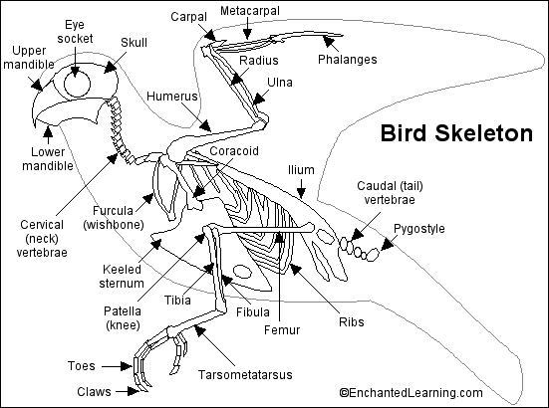
3) skeleton made of hollow bones

Slide 26
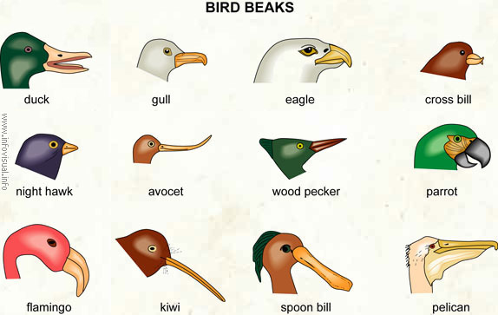
4) toothless beak
a) several different shapes

Slide 27
5) eyes on either side of head
a) some birds an exception (ex. owls)
6) more vertebrae on neck than other vertebrates
a) can turn head 180°

Slide 28
7) endothermic
a) can regulate body temperature
i) 45°C
8) internal fertilisation
a) amniotic egg
b) mother/father cares for young

Slide 29
9) 4 chambered heart

Slide 31
VI) Mammals
A)characteristics
1)highly developed brain
a) large cerebrum
b) convolutions

Slide 33
2) endothermic
3) breathe using diaphragm
4) hair
a) blubber in aquatic mammals
i) more stream-lined

Slide 36
5) 4 types of glands
a) sweat glands (regulate body temp.)
b) sebaceous glands (lubricate hair, skin)
c) scent glands (communication)
d) mammary glands (nourish young)
6) highly developed teeth
a) diverse diets (herbivores, carnivores,
omnivores)

Slide 39
7) internal fertilisation
a) young develops in uterus
i) mother/father cares for young

Slide 40
8) 4 chambered heart
B) 3 mammal groups
1) monotremes (ex. duck-billed platypus, echidna)
a) lay eggs
b) milk from sweat glands

Slide 41
2) marsupials
a) original development in uterus
b) further development in pouch
c) milk from mammary glands
*

Slide 42
3) placental mammals
a) long gestation period
i) remain in uterus until highly developed
ii) placenta nourishes young through umbilical cord
b) young nourished with milk

