Slide 1
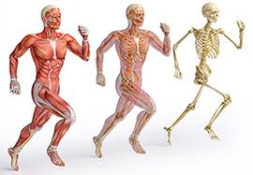
Musculoskeletal System
Pg 221…

Slide 2
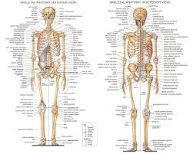
Skeleton
Bones
With our bones we have a body shape
Adults have 206 bones in their bodies

Slide 3
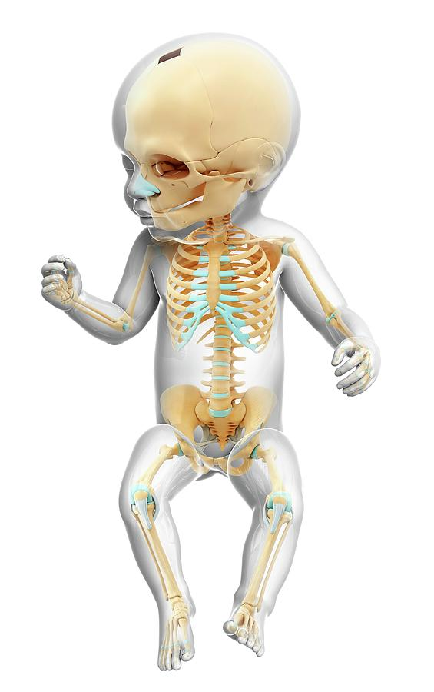
When you are born you have more bones than this but they fuse together (esp in the head)
Grouped in 3 areas:
Head, trunk, limbs
Pg. 221 Fig 7.38

Slide 4
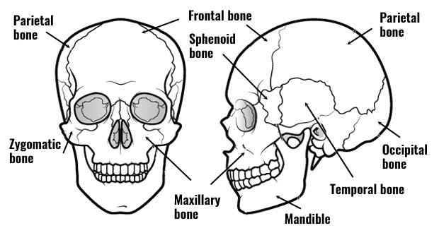
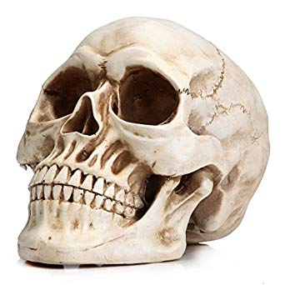
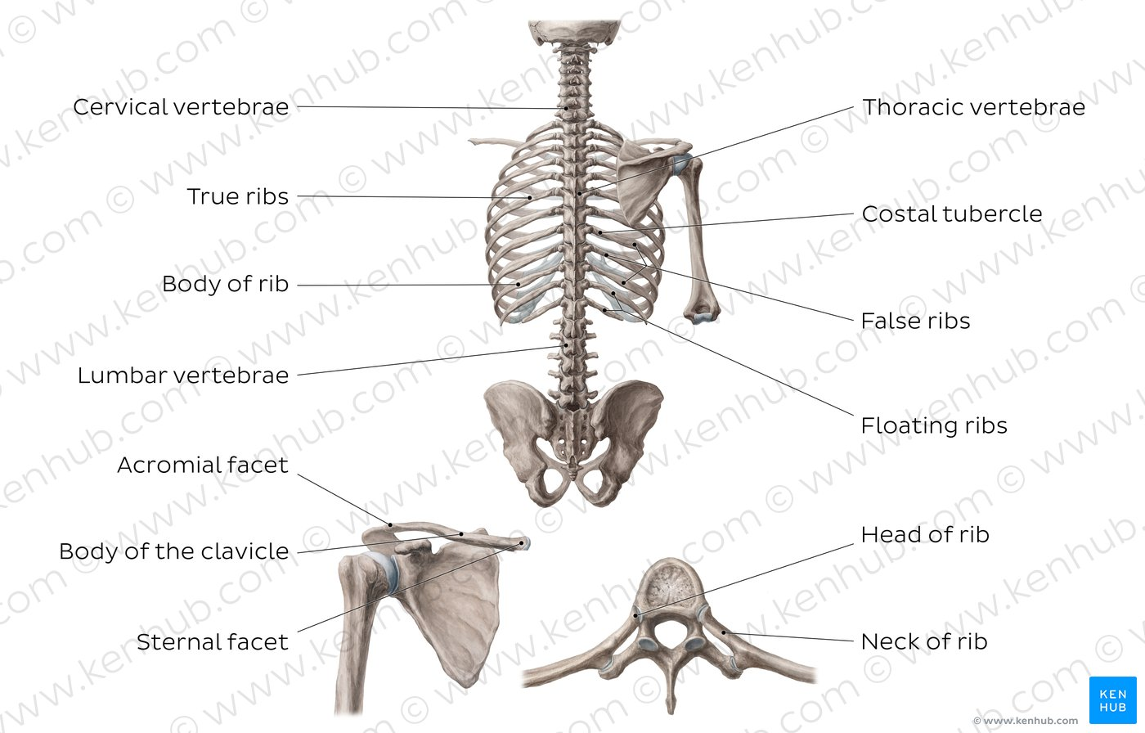
Name the parts of the skeleton
Head:
Frontal bone
Temporal bone
Parietal bone
Mandible (jaw)
Trunk:
Scapula
Clavicle
Sternum
Ribs
Vertebrae

Slide 5
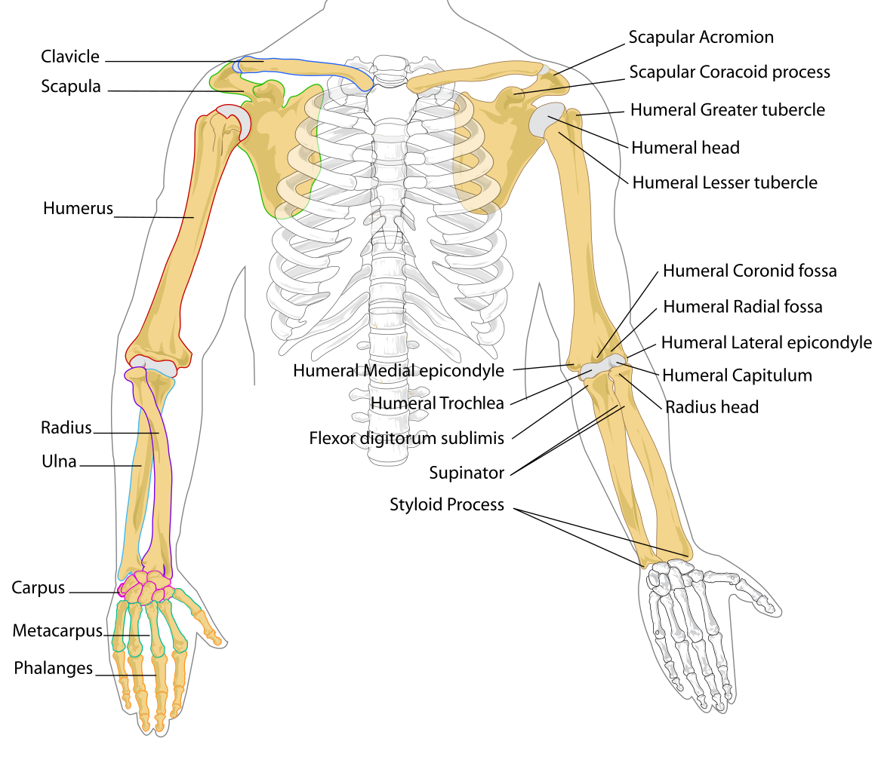
Cont. bones
Limbs (arm)
Humerus
Ulna
Radius
Carpals
Phalanges of hand

Slide 6
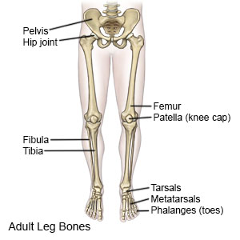
Cont. Bones
Limbs (leg):
Femur
Patella
Tibia
Fibula
Tarsals
Phalanges of the foot

Slide 7
Bone
Bone is a hard, solid organ that forms part of the skeleton
Bones continuously renew themselves
2 types of bone:
Spongy bone and compact bone
Spongy bone has many small cavities (holes)
Compact bone is dense
Bones come in variety of shapes and sizes

Slide 8
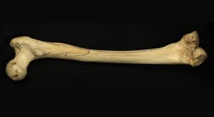

Slide 9
Bones
Long bone [long, thin body (diaphysis), 2 rounded ends (epiphysis), mainly compact bone, centre is AKA marrow, mainly in limbs]
Ex: Humerus
Short bone [cubic, mainly spongy bone, heels and wrists]
Ex: Carpal bones (in the hand)
Flat bone [thin, flat, generally curved, 2 thin compact layers with spongy in middle (like an oreo), skull, ribs, scapula]
Ex: Parietal (bone in the skull)
Irregular bone [cannot be grouped together, all irregular, mainly in the spine]
Ex: vertebrae

Slide 10
4 types of Bones

Slide 11
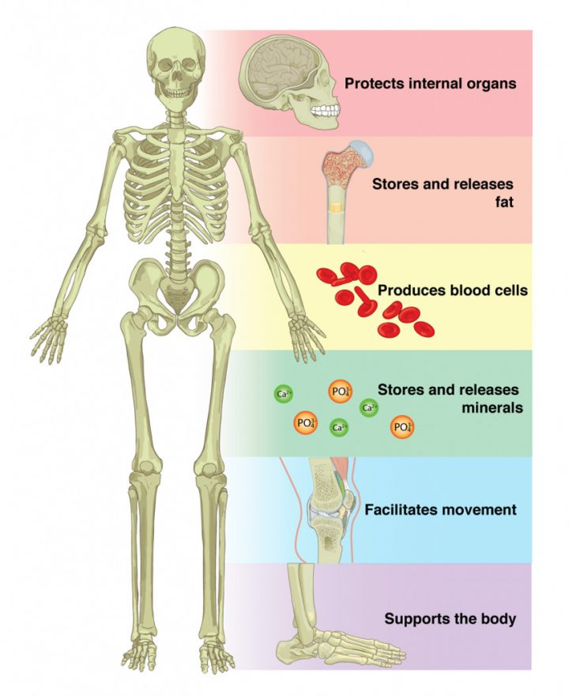
Functions

Slide 12
Functions of bones
Supports the body
Protects internal organs
Facilitates movement
Storage
Production of blood cells
Take a look at the table on Pg. 223

Slide 13
Joints
Is the junction between two or more bones
Provides mobility
Almost all bones have at least one joint
What is synovial fluid?
Synovial fluid, is a viscous fluid found in the cavities of synovial joints.
With its egg white–like consistency, the principal role of synovial fluid is to reduce friction between the articular cartilage of synovial joints during movement
Ligaments help to reinforce the joints are fibrous bands of tissue
https://www.youtube.com/watch?v=DLxYDoN634c

Slide 14
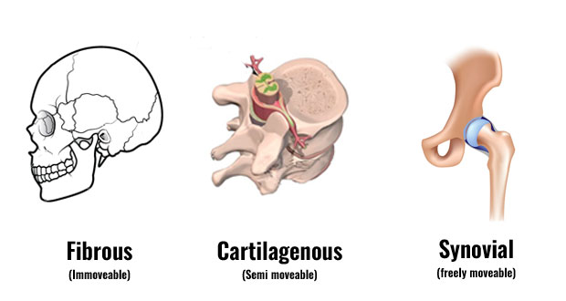

Slide 15
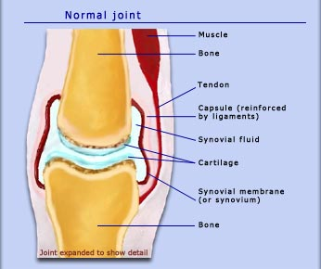

Slide 16
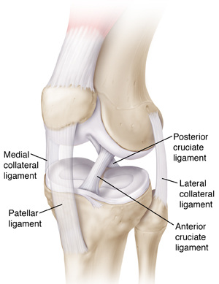
Mobility of Joints
Degree of mobility can vary
Fixed, no movement between bones ex: skull
Semi-movable, some movement but not a lot ex: vertebrae
Freely movable joints, move easily ex: elbow and hip (wide variety of movable joints)

Slide 18
Mechanics of Joints
Various movements are possible because of joints
Extension and flexion
ABduction and ADduction
Rotation

Slide 19
Flexion/Extension

Slide 20
ABduction/ADduction

Slide 21
Rotation

Slide 22
https://www.youtube.com/watch?v=VVL-8zr2hk4

Slide 23
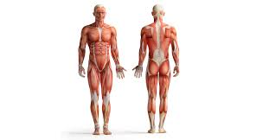
Muscles
Muscles: have the ability to contract causing our bodies or our internal organs to move
Help with movement, posture, joint stabilization, heat release

Slide 24
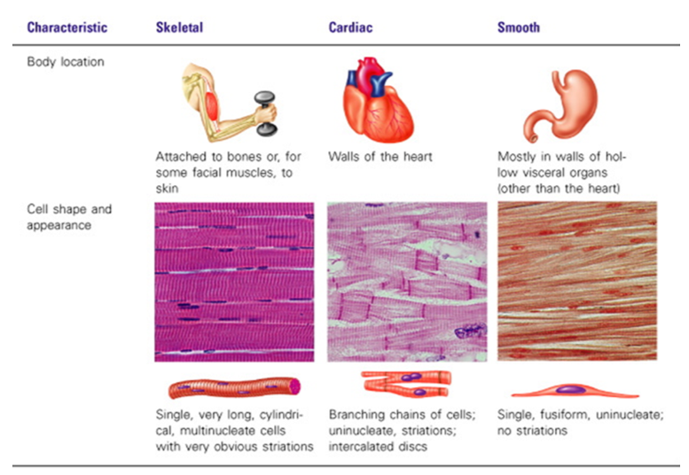
Types of muscles
3 types:
Skeletal
Smooth
Cardiac

Slide 25
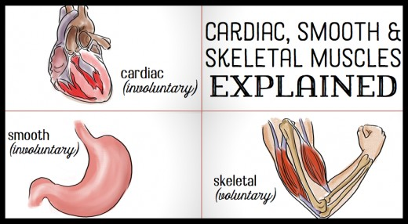
Voluntary or involuntary
Strength
Endurance
Location

Slide 26
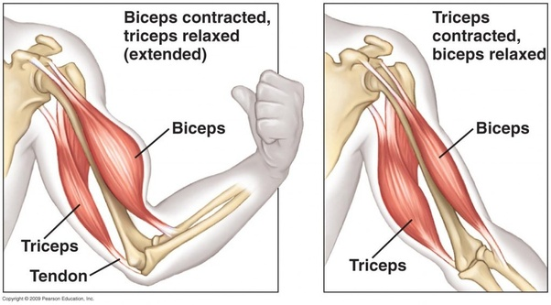
Musculoskeletal
What does the musculoskeletal system do?
Functions: protection, reaction, posture, movement
Parts:
muscles: bicep, hamstring
Skeletal: (bones) parietal, femur, clavicle

Slide 27
Why do we need this system to survive?
List something that is important to you in your life that makes you rely on this system
https://www.youtube.com/watch?v=ynVRDsDC-84

Slide 28
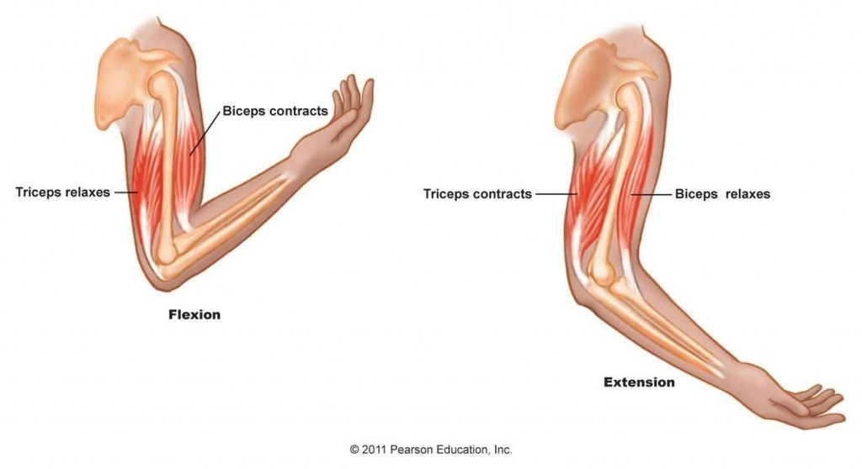
Antagonistic muscles
When one muscles is working, the other one gets to rest
Can you show me some examples?

Slide 29
Muscles
a muscle that opposes the action of another; the biceps and triceps are antagonistic muscles
All muscles work in pairs,
when a muscle works it needs to have an agonist and an antagonist
Agonist muscle: contracting muscle that is resisted or counteracted by another muscle, the antagonist

Slide 30
https://www.youtube.com/watch?v=SYTqXWXUaJA

