Slide 1
Cells
Dividing to Multiply

Slide 2
What do we know about cells?
Take 10 minutes and record what you know about the cell. This can be done in point form, by creating a mind map, a table or through a free write.
We will then go over together what we know and create a concept map as a class that can be added to our notes. (The info you record will be collected at the end of class)
The following prompts may be useful as you complete this activity:
Definition Types Parts (of) Function(s) | Size Growth Living? Importance

Slide 4
Conditions Essential for Life
The conditions essential for the emergence of life on earth are the conditions that made it possible for the synthesis of the first organic molecules and their development into living cells
These conditions are:
Presence of essential chemical elements
Presence of an energy source
Presence of liquid water
A very long period of time

Slide 5
Conditions Essential for Life
 | Essential Elements | Energy Source | Liquid Water | Time
Description | Carbon, Oxygen, Hydrogen & Nitrogen | The synthesis of complex molecules requires a high amount of energy | Water provides the essential elements hydrogen and oxygen as well as provides a medium (location) for reactions to take place | Based on fossil evidence, the first living cells appeared between 3.8 and 3.5 billion years ago
Source(s) | Early Earth’s atmosphere | -UV rays from the sun, -Electrical discharges by lightening, -Heat released from volcanoes | ???? Yet unknown?????
Other | The presence of the required elements in the atmosphere would allow for the first complex organic molecules |  | Very strong evolutionary evidence to support the emergence of the first living organisms occurring in water | Probability of the right combinations of factors to produce life: 1 in 1 000 000 000

Slide 6
Cells
The cell is the building block of all living organisms.
We are made of about 10,000 billion cells.
At the beginning all cells are the same, but as they develop they become specialized.
There are about 200 types of cells that vary in function

Slide 7
Review of Cells
Structures most essential for cellular reproduction:
Cell Membrane: flexible barrier which protects the cell, and controls what can enter and exit the cell.
Cytoplasm: fluid inside the cell membrane which allows substances to circulate in the cell
Nucleus: Controls cells activities (growth and reproduction) and contains DNA
Nuclear Membrane: protects the nucleus and controls exchanges between nucleus and the rest of the cell

Slide 8
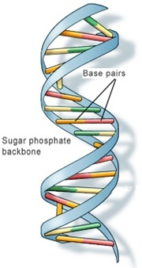
DNA
DNA stands for Deoxyribonucleic Acid
A complete molecule of DNA is called a chromosome.
A DNA molecule is a double helix structure which when straightened looks like a ladder.
Each “bar” in the ladder is called a nucleotide and is made of 2 base pairs.
There are 4 bases: Adenine (A), Cytosine (C), Guanine (G) and Thymine (T)
They are always paired: A – T and G – C
The order in which these base pairs are arranged determines the genetic information

Slide 9
Chromosomes & Genes
Chromosomes: structures containing an individual’s genetic code. In animal and plant cells, the chromosomes are located in the nucleus.
Chromosomes contain:
Genes: chromosome segments that determine specific genetic characteristics. We all have similar genes but minor differences make us all unique.
Genes are segments of DNA that determine a particular genetic characteristic. They can be dominant or recessive. Gene contains codes for hereditary traits such as eye color, skin color, etc.
Chromosomes form when DNA packs itself up tightly by coiling itself again and again until it is shaped like an X.

Slide 10
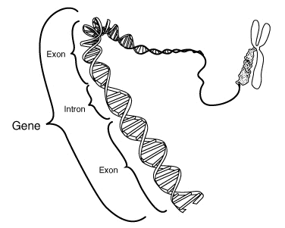

Slide 11
Cell Division:
Cells divide for three reasons:
To increase in numbers and allow growth (somatic/diploid cells (2n))
Tissue repair (somatic/diploid cells (2n))
Sexual reproduction (haploid cells (n))
** But they are not always dividing. Mostly they are ensuring the proper functioning of the human organism.**

Slide 12
How cells multiply
Cells use mitosis to multiply.
Mitosis: process of cell division in which the original cell divides to produce two identical cells called daughter cells (diploid cells (2n)).
Used for the growth of new cells and to repair damaged tissue

Slide 13
Mitosis
Ensures growth (an increase in the number of cells that make up an organism).
When our bodies grow so does the # of cells, so we have more cells when we are adults than when we are babies
Mitotic activity: # of mitoses carried out by cells (more intense during childhood and adolescence than any other stage of life)
Ensures repair of damaged tissues, repair areas of the body that have been accidentally damaged (ex. Injuries, cuts, fractures and hemorrhages)
Certain cells wear down more easily than others and need replacing more often (eg. Skin cells are replaced every 2 wks and white blood cells every 120 days)

Slide 14
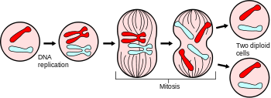
Process of Mitosis
https://www.youtube.com/watch?v=f-ldPgEfAHI
DNA is doubled before the cell divides (process called “DNA replication”). To do this, the DNA unzips like a zipper and new bases are added in the right order and attach to each of the separate strands, forming 2 identical DNA strands.
DNA Replicates
Chromosomes are formed
DNA lines up in center
Chromosomes split up and go to opposite ends
Cell divides creating two daughter cells (diploid cells) with the same genetic information.

Slide 15
Meiosis
https://www.youtube.com/watch?v=toWK0fIyFlY
Meiosis is a form of cell division that produces 4 reproductive cells that are different from the original cell because they each contain half the DNA
The result is 4 daughter cells, each contain 23 chromosomes and all different genetic material.
Each daughter cell ends up with half the genetic info. These are called haploid (n) cells.
This is used to create sex cells
Sex Cells: Sperm and ova (eggs), are also called gametes

Slide 16
In order to produce cells that contain only half the DNA, there are TWO divisions that take place.
The first one is similar to mitosis (where DNA doubles itself first)
The second division happens right after the first division, but without duplicating the DNA
During fertilization millions of spermatozoa (n) encounter the ovum (n).
Only one of the sperm will be able to penetrate the ovum and combine the male genetic info (n) with that of the female (n) to produce a zygote (2n).
Further mitosis results in the development of an embryo (first steps to a baby)

Slide 17
Mitosis vs Meiosis
Using your notes, create a Venn Diagram to compare Mitosis and Meiosis

Slide 18
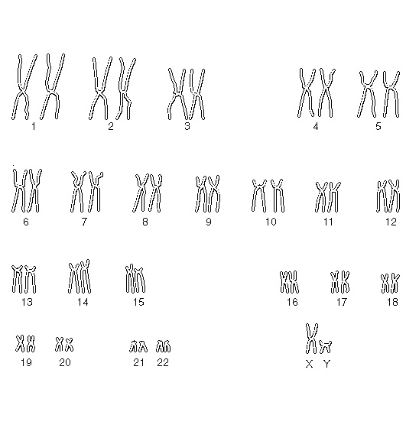
Cellular Organization
Remember: 23 pairs give a total of 46 chromosomes of which ½ come from the mother and ½ from the father.
22 of the 23 pairs are similar in both sexes
The 23rd pair is the sex chromosomes
A chart showing the pairs of chromosomes in descending order of size is called a caryotype

Slide 19
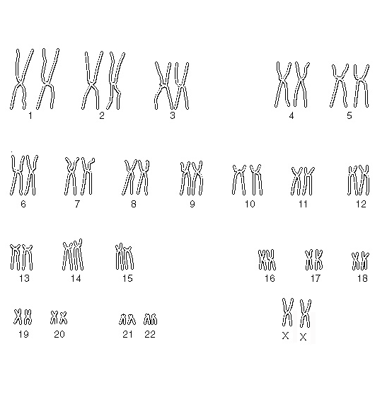
Caryotype of a male
Caryotype of a female

Slide 20
Genetic Diversity
Every human being is unique.
The pairs of chromosomes that the offspring receive from their parents is pure chance.
It is pure chance which sperm and ovum will combine.
Genetic diversity:
is the variation of genes among the individuals of the same species.
Prevents extinction of a species

Slide 21
Factors that contribute to Genetic Diversity
Genetic recombination: similar chromosomes exchange parts of their genes during the beginning of meiosis
Genetic mutation: where random changes happen in the bases of DNA (A,C,T,G). This can be caused by UV rays, X rays or cigarette smoke.
Population mixing: where individuals from different populations breed

Slide 22
What’s after Cells?
Single celled organisms can perform all the basic functions to survive.
Multi-celled organisms being more complex require cells to specialize and work together to perform these same functions.
These cells are grouped into:
Tissues
Organs
Organ Systems
Organism

