Slide 1
Optics and Waves
Light and Sound

Slide 2
Waves
A wave is a disturbance which travels through a vacuum or medium (air, water, etc) that contains matter
A wave transports ENERGY not matter
A wave in a vacuum does not need a medium to travel – outer space, x-rays, light waves
A wave in a medium needs matter to allow it to travel – sound needs air to travel, outer space = no air = no sound

Slide 3
Electromagnetic Spectrum
The organization of all electromagnetic waves according to their wave length and frequency
Frequency: the number of cycles in a given unit of time
Amplitude: Maximum distance travelled from equilibrium (no movement)

Slide 4
Diagram Examples
Crest
Long Wave Length = Low Frequency
Wave Length
Amplitude
Trough
W L
Short Wave Length (WL) = High Frequency

Slide 5
Classification on Electromagnetic Spectrum
Types | Radio Waves | Infrared | Visible Light | UV Rays | X-Rays | Gamma Rays
Frequency
Energy
Tech Applications
Interesting Facts

Slide 6
Types | Radio Waves
Frequency | Lowest
Energy | Lowest
Tech Applications | -Radio -Cell phones -TV -MRI -Microwaves
Interesting Facts | Antennas are used, which connect the signals

Slide 7
Types | Infrared
Frequency | Higher
Energy | Higher
Tech Applications | -Night Vision Goggles -Wireless Keyboard -Satellites
Interesting Facts | -Heat is emitted (given off)- “feels warm” -Some animals use infrared to locate their prey

Slide 8
Types | Visible Light
Frequency
Energy
Tech Applications | -Laser -microscopes -computer screens
Interesting Facts | -Only wave length we can see -Red = longest wave length of visible light -Violet = shortest wave length of visible light - When visible light hits water vapour = rainbow

Slide 9
Types | UV Light
Frequency
Energy
Tech Applications | -Sterilize Equipment -Treatment for Jaundice
Interesting Facts | -Necessary for Vitamin D -Causes Cancer -Animals can sense them

Slide 10
Types | X-Rays
Frequency
Energy
Tech Applications | -X-Rays -Baggage and Body inspection at airport
Interesting Facts | -Too much can also cause cancer

Slide 11
Types | Gamma Rays
Frequency | Highest
Energy | Highest
Tech Applications | - Preserving food -Cancer treatment
Interesting Facts | - Given a + or – charge for cancer treatments -Kills microbes in food

Slide 12
(Visible) Light
Electromagnetic waves that are visible to the human eye
ROYGBIV
Travel in straight lines
Does not need a medium
How do we see colour? (to see Red = all of the other colours are absorbed, except Red that is reflected back to our eyes)
How do we see black or white? (absorb/reflect)

Slide 13
https://www.youtube.com/watch?v=IXxZRZxafEQ

Slide 14
Bill Nye- Light Optics
https://www.youtube.com/watch?v=G9EfdeeHQDs

Slide 15
Reflection
Occurs when light hits a medium and bounces back towards the direction it came from
Reflection is what allows us to see objects:
Lights reflects off an object and travels into the eyes → sight

Slide 16
Reflection Diagram
Definitions:
Incident Ray: the ray that contacts the surface an object
Reflected Ray: the ray that rebounds
Normal: a line perpendicular to the surface at the point of reflection
Angle of Incidence: the angle formed between the incident ray and the normal
Angle of Reflection: the angle formed by the reflected ray and the normal

Slide 17
Reflection of Light
Normal
Angle of Incidence
Angle of Reflection
Incident Ray
Reflected Ray

Slide 18
Laws for Reflection of Light Rays
The angle of incidence is always equal to the angle of reflection
The incident ray and the reflected ray are always in the same plane

Slide 19
Reflection and Mirrors
When parallel light rays contact a surface such as a mirror, their reflections are parallel resulting in a true mirror image
A mirror with no curve, or that is flat is called a plane mirror
Reflections from plane mirrors have several characteristics:

Slide 20
The image appears to be behind the mirror
The distance between the object and the mirror and the reflected image and the mirror are equal in appearance
The image in the mirror is called a virtual image
A virtual image is not real and therefore cannot be captured on a mirror; it is made by lengthening the reflected rays

Slide 21
Virtual Images
Mirror
Reflected Rays
Reflected rays extended
Incident Rays
Object
Virtual Image

Slide 22
Uses of Plane Mirrors
The two principles that make plane mirrors useful are:
They change the trajectory (pathway) of light rays by reflection
This increase the observer’s field of vision
Uses: rear-view mirrors, microscopes, and telescopes

Slide 23
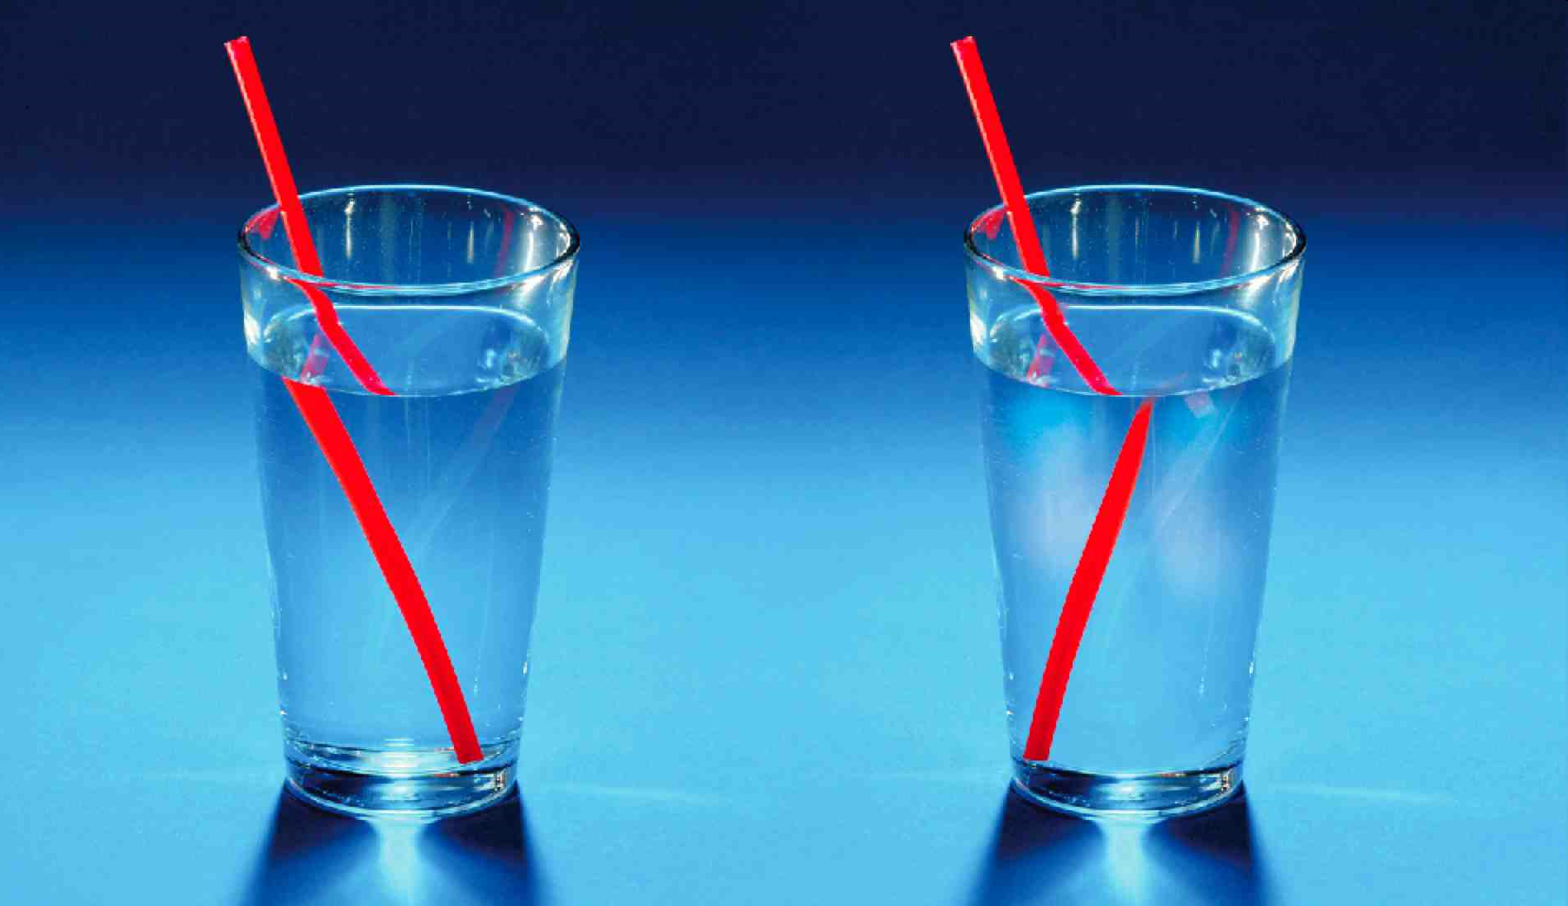
Refraction
Refraction: the deviation of a light ray as it passes from one transparent medium to another
Occurs when the pathway of a light ray is changed
Most often occurs as light goes from air to water
Happens because the speed that light travels changes as the medium changes

Slide 24
Lenses
Lenses are made of transparent materials and have at least one curved surface
The curve of a lenses allows it to refract light as it passes through
There are two types of lenses
Converging lenses
Diverging lenses

Slide 25
Converging lenses bring light rays together
Diverging lenses disperse light rays
Surfaces of the Lens
Optical Centre (OC)
Principal Axis
Lens

Slide 26
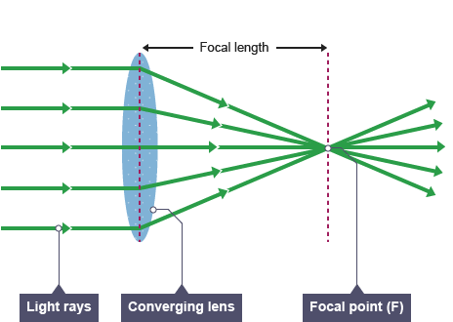
Focal Point: Converging Lens
The focal point of a converging lens is the REAL POINT where the refracted rays ACTUALLY meet when the incident rays run parallel

Slide 27
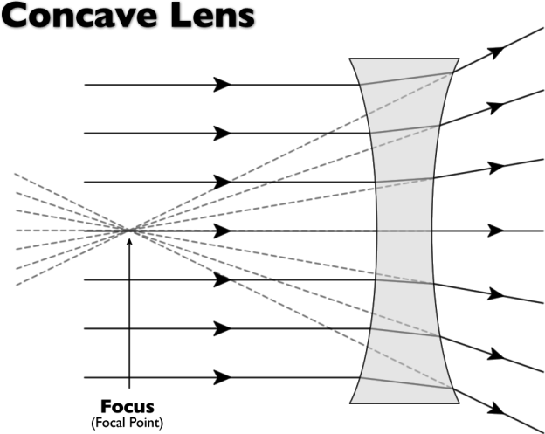
Focal Point: Diverging Lens
The focal point of a diverging lens is the VIRTUAL point from which the refracted light rays APPEAR to emanate when the incident rays run parallel

Slide 28
Sound Waves
Sound is a longitudinal wave produced by the vibration of an object and transmitted to the object’s environment
Anything that creates sound produces a longitudinal mechanical wave: loudspeakers, musical instruments and thunder cause the air particles around them to vibrate

Slide 29
https://www.youtube.com/watch?v=uENITui5_jU
Look at how we can 'see' sound!

Slide 30
Speed of Sound
The speed at which sound travels changes from one medium to another
The most common reference point is the speed of sound in air: 340 m/s
Sound travels faster in liquid or solid medium- example: water = 1490 m/s, steel = 5200 m/s

Slide 31
The Decibel Scale
The volume of a sound depends on its intensity, which is the amount of energy being transmitted
The greater the energy, the louder the sound
The decibel scale is a relative scale that represents the perception of the intensity of sound by the human ear

Slide 32
Variations on the decibel scale are measured in factors of 10
For each increase of 10 dB, a sound is 10 times louder (Example: a sound that is 20 dB is 100 times louder than a 0 dB sound)

Slide 33
Reflection of Light
Normal

Slide 34
Virtual Images
Mirror

Slide 35
Diagram Examples
Long Wave Length = Low Frequency
Short Wave Length (WL) = High Frequency

